Slide 1
THE DUKE OF EDINBURGH’S AWARD
In Association with…

Slide 2
The Award comprises 3 levels:
Bronze
Silver
Gold

Slide 3
Why do DofE
Personal challenge.
Someone who has their BRONZE, SILVER or GOLD Awards will set their CV apart from their competitors.
Develop Independence
Have fun with friends!
The Duke of Edinburgh’s Award is the largest and most successful youth development program worldwide.

Slide 4
What does DofE Involve?
By taking part in the sections, you will find yourselves:
Getting fitter
Helping others and the community
Developing skills
Going on expeditions
An Award is achieved by completing a personal programme of activities in 4 sections

Slide 5
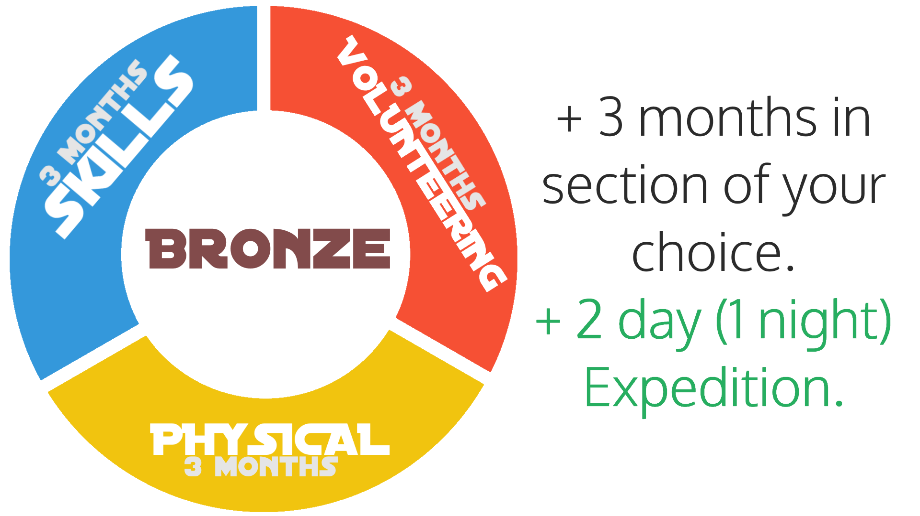
Award Requirements

Slide 6
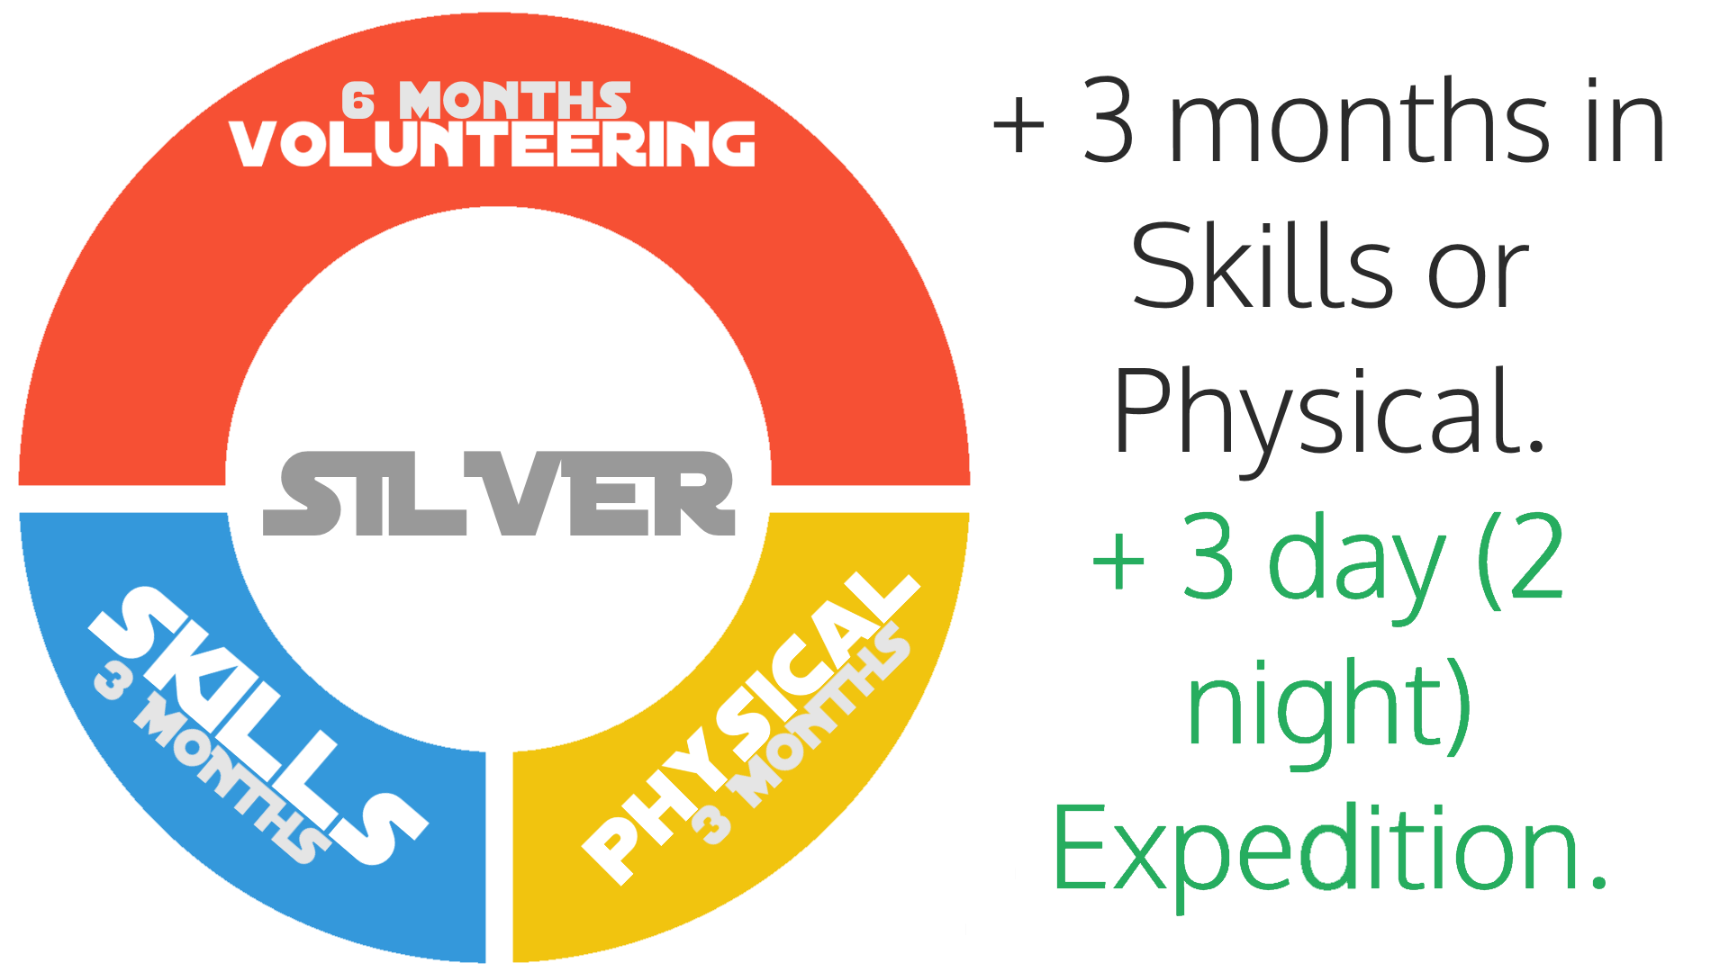
Award Requirements

Slide 7
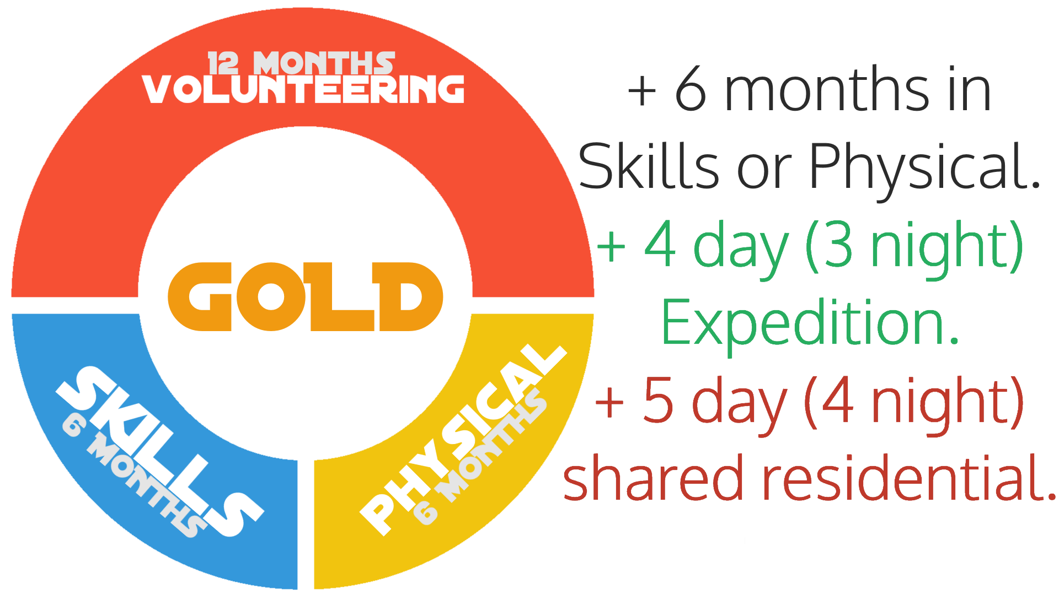
Award Requirements

Slide 8
Skill, Volunteering & Physical Recreation
Minimum 1 hour per week per activity.
A shorter, more intensive period does not count.
Signing up and not turning up also does not count!
Report in your logbook will be written upon completion.

Slide 9
Skill, Volunteering & Physical Recreation
If you need to you can do more than one activity within the time frame, eg: Summer Term: Netball Autumn Term: Hockey

Slide 10
Skill, Volunteering & Physical Recreation
What Counts?
Any activities that are non compulsory.
If you normally play for a team you may wish to consider making your Physical Recreation the longer section.

Slide 11
Example Section Options:
Skill
Playing a musical instrument
Keeping of pets
Dog training & handling
Performing Arts
Cookery
Writing
First Aid
DIY
Physical
Golf
Running
Diving
Rowing
Football
Tennis
Hockey
Netball
Swimming
Volunteering
Fundraising
Animal welfare
Girlguiding UK
Scout Association
Sports leadership
Promotion & PR
Music tuition
Youth work
Music tuition

Slide 12
Expedition Section
The Expedition Section is split into 3 parts, each of which must be completed successfully:
Training Weekend
Practice Expedition
Assessed Expedition

Slide 13
Expedition Section
Training
Bronze
2 Days & 1 Night
Silver
2 Days & 1 Night
Gold
2 Day & 1 Night
DofE Training Syllabus completed.
Directly Supervised
Practice Expedition
Bronze
2 Days & 1 Night
Silver
3 Days & 2 Nights
Gold
4 Days & 3 Nights
Directly & Remotely Supervised
Assessed Expedition
Bronze
2 Days & 1 Night
Silver
3 Days & 2 Nights
Gold
4 Days & 3 Nights
Remotely Supervised
Groups of 5 to 7 Participants
(5 to 8 for Canoeing)

Slide 14
How Much Will It Cost?
Bronze Walking - £310
Bronze Canoeing - £410
Silver Walking - £410
Silver Paddling - £510
Gold Walking - £525

Slide 15
What is Included?
Training Expedition
Practice Expedition
Assessed Expedition
Equipment included:
Roll Mat
Trangia
Tent
Sleeping Bag
Rucksack
Navigation Equipment

Slide 16
Thanks for Listening Charlie Metcalfe – Inspired Expeditions Miss Wilkins – St. Mary’s School

